Slide 1
Intro to the Second half of Calculus
A dramatic reading by Ms. Lomax
Notes:
I read overview on page 267 to students and then they answer questions.

Slide 2
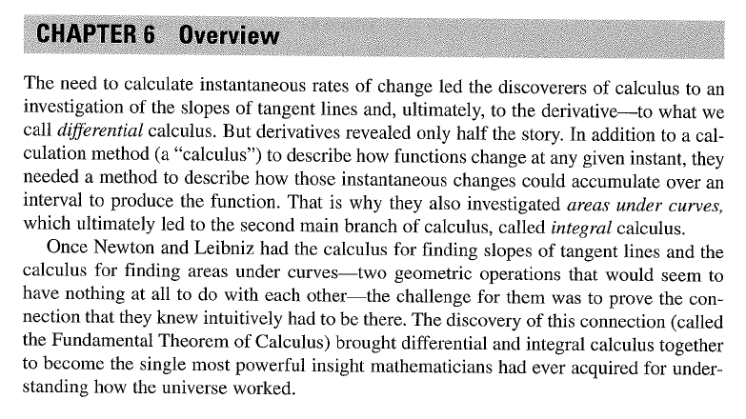

Slide 3
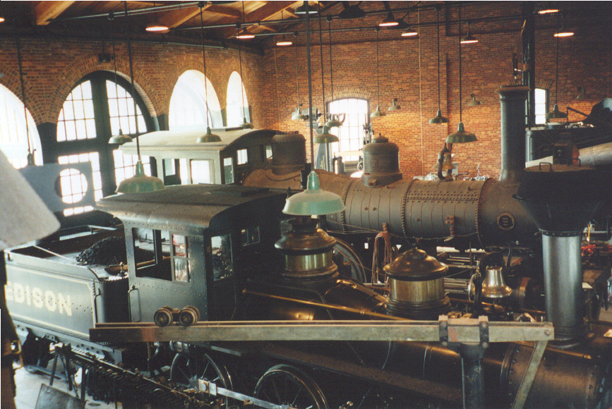
5.1: Estimating with Finite Sums
Greenfield Village, Michigan
Photo by Vickie Kelly, 2002
Greg Kelly, Hanford High School, Richland, Washington

Slide 4
Objectives
You will be able to use four different methods to approximate the area under a curve.

Slide 5

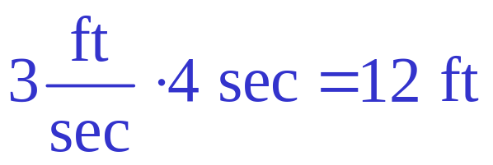

Consider an object moving at a constant rate of 3 ft/sec.
Since rate . time = distance:
If we draw a graph of the velocity, the distance that the object travels is equal to the area under the line.
After 4 seconds, the object has gone 12 feet.
velocity
time

Slide 6
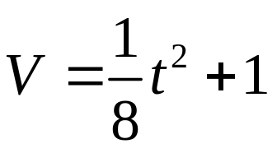








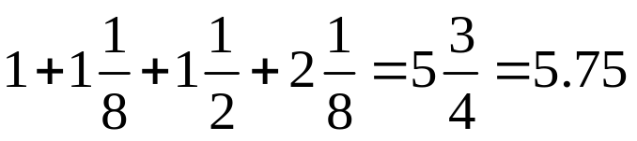

If the velocity is not constant,
we might guess that the
distance traveled is still equal
to the area under the curve.
(The units work out.)
Example:
We could estimate the area under the curve by drawing rectangles touching at their left corners.
This is called the Left-hand Rectangular Approximation Method (LRAM).
Approximate area:

Slide 7
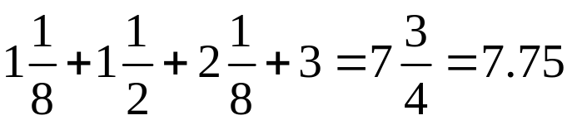
We could also use a Right-hand Rectangular Approximation Method (RRAM).
Approximate area:

Slide 8









Another approach would be to use rectangles that touch at the midpoint. This is the Midpoint Rectangular Approximation Method (MRAM).
Approximate area:

Slide 9
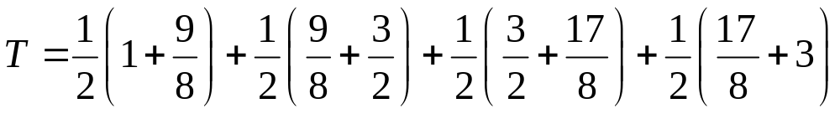
Averaging right and left rectangles gives us trapezoids:

Slide 10
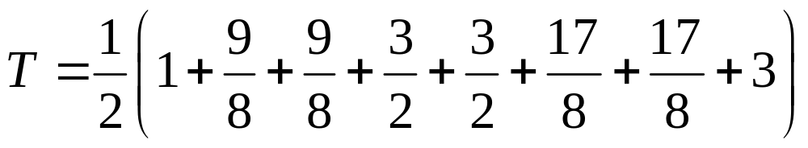
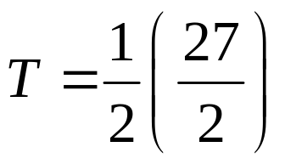
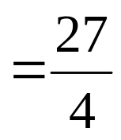


Slide 11
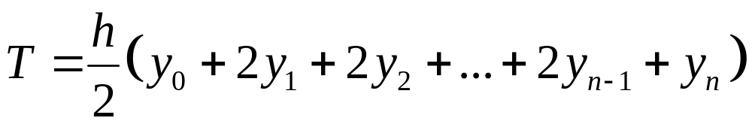
Trapezoidal Rule:
( h = width of subinterval )
This gives us a better approximation than either left or right rectangles.

Slide 12
We will be learning how to find the exact area under a curve if we have the equation for the curve.
Rectangular approximation methods are still useful for finding the area under a curve if we do not have the equation.
Notes:
Homework: example 1 pg. 268 (Demana): all four methods with n=3

Slide 13
However…
Which rectangular approximation is more accurate?
How do we know if the approximation is an overestimate or an underestimate?
How do we make each rectangular approximation more accurate?

Slide 14
Group Activity
In groups of four you will approximate the area under the curve
Each person in the group must pick a method to solve the problem: Left hand, Right hand, Midpoint, or Trapezoid
Each group will be given a different number of rectangles to use to approximate the area under the curve

Slide 15
Group Names | Number of Shapes | Left-hand Method | Right-hand Method | Midpoint Method | Trapezoid Method
 | 3
 | 5
 | 10
 | 25
Lomax | 50
Lomax | 100
Lomax | 1000

Slide 16
5.1 Approx. HW
Pg. 296 – 297: #6, #11 (graph/table: L,R,M)
Pg. 465: #105 (trapezoid)

